Slide 1
Real Time Communication with IoT and Morse Code Interpreter
Abhijeet Gaonkar
Prabhat Jaiswar
Saurav Bhosale
Amogh Sadhu

Slide 2
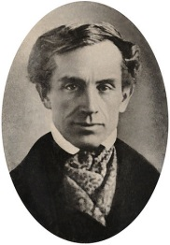
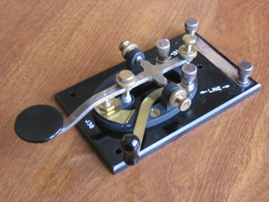
Introduction
Domain:-Instruments for disabled.
Partially paralyzed individuals who are not able to speak face a major problem in communication.
Morse Code Interpreter.
Encoded message will be displayed on a android app.
SAMUEL MORSE

Slide 3
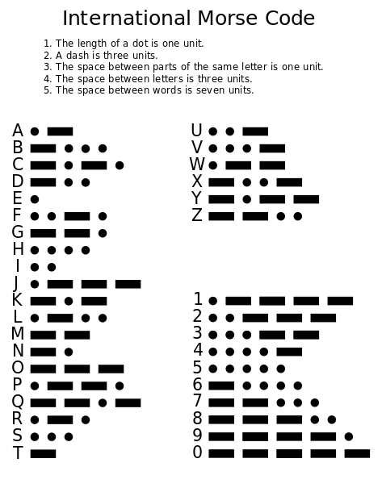

Slide 4
Hardware
Arduino UNO(328p).
Bluetooth Module (HC-05).
Passive Buzzer.
Limit Switch.
Push Button.
Resistor(10k ohm).
LED.
Mini Zero PCB Board.

Slide 5
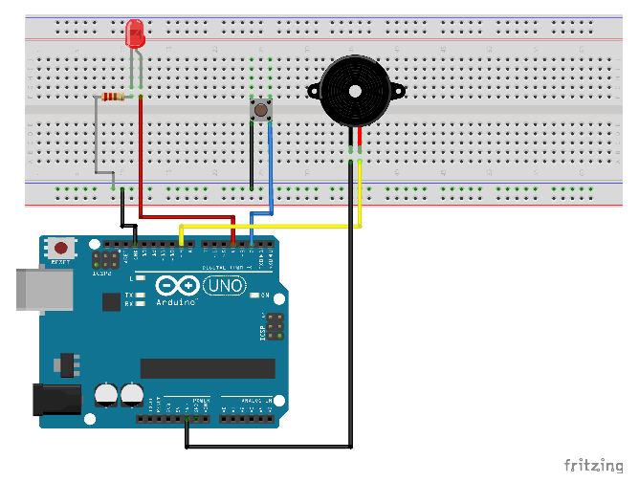
Prototype Circuit

Slide 6
Software
Programming on Arduino IDE.
Interfacing Bluetooth Module.
MIT App Inventor

Slide 7
Timeline
10/01/20 : morse code interpreter.
04/02/20 : Android App.
10/02/20: Interfacing Bluetooth Module.

Slide 8
Thank You

